Slide 1

Exploratory Data Analysis on AMCAT

Slide 2

ABOUT ME
My name is M.Janath Kumar. I am from Hyderabad, which is located in Telangana. I am currently a final-year student at Mahatma Gandhi Institute of Technology, Hyderabad, pursuing a B.Tech in Data Science. I want to learn Data Science because of I’m particularly interested in learning more about the Data Analysis, Machine Learning Algorithms, and Data Visualization Techniques.
My goal is to become a recognized leader in Data Science.
LinkedIn URL: https://www.linkedin.com/in/janath-maliga/

Slide 3
About the Data:
The dataset was released by Aspiring Minds from the Aspiring Mind Employment Outcome 2015 (AMEO). The study is primarily limited only to students with engineering disciplines. The dataset contains the employment outcomes of engineering graduates as dependent variables (Salary, Job Titles, and Job Locations) along with the standardized scores from three different areas – cognitive skills, technical skills and personality skills. The dataset also contains demographic features. The dataset contains around 40 independent variables and 4000 data points.
Objective:
Times of India article dated Jan 18, 2019 states that “After doing your Computer Science Engineering if you take up jobs as a Programming Analyst, Software Engineer, Hardware Engineer and Associate Engineer you can earn up to 2.5-3 lakhs as a fresh graduate.” Test this claim with the data.

Slide 4
Dataset Description:
The dataset consists of 4000 data points with 40 columns. The features are of type categorical, numeric discrete and numeric continuous. Following are the categories in which the different columns come.
Numerical Discrete Features :
'English', 'Logical', 'Quant', 'Computer Programming', 'Electronics and Semicon', 'Computer Science', 'MechanicalEngg', 'ElectricalEngg', 'TelecomEngg', 'CivilEngg’.
Numerical Continuous Features:
'Salary', '10percentage', '12percentage', 'collegeGPA', 'Domain', 'conscientiousness', 'agreeableness', 'extraversion', 'nueroticism', 'openess_to_experience’.
Categorical Features:
'Designation', 'JobCity', 'Gender', '10board', '12board', 'Degree', 'Specialization', 'CollegeState’, 'CollegeTier’, 'CollegeCityTier'.

Slide 5
Data Cleaning:
Duplicates: Identifying and removing identical rows or records that occur more than once in the dataset. There are no duplicate values found in the dataset.
Structural Errors: Correcting inconsistencies in the structure or format of the data, such as mislabeled columns, inconsistent date formats, etc. Here in the dataset i’ve replaced or corrected identified structural errors to maintain consistency within the dataset.
Missing Values: Handling missing data by either imputing values based on statistical methods or removing records with missing values. Missing values in numerical columns have been identified as '-1' for clarity and that these values will be handled appropriately during further analysis.
Outliers: Detecting and handling outliers that may significantly skew statistical analyses or machine learning models.

Slide 6
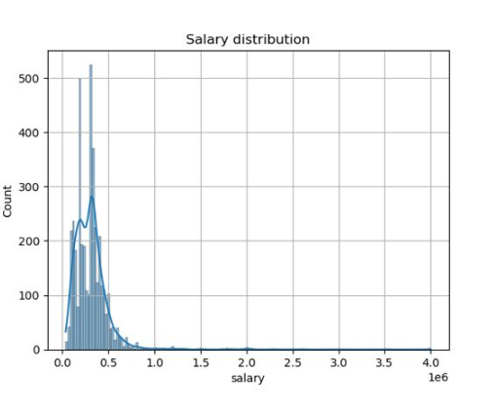
Univariate Analysis:
The salary distribution is highly right=skewed, with the majority of salaries concentrated below 500,000.
A significant peak is observed around 400,000 indicating a large number of employees earning within this range.
The long tail extending to 4,000,000 suggests the presence of high earning outliers

Slide 7
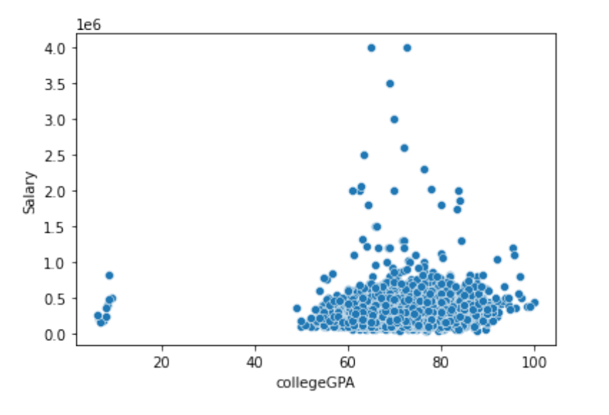
Bivariate Analysis
The scatterplot between salary and college GPA reveals a scattered distribution, lacking any discernible trend or pattern, suggesting no correlation between the two variables. This implies that factors beyond GPA likely influence salary determinations, emphasizing the complexity of salary determination processes.

Slide 8
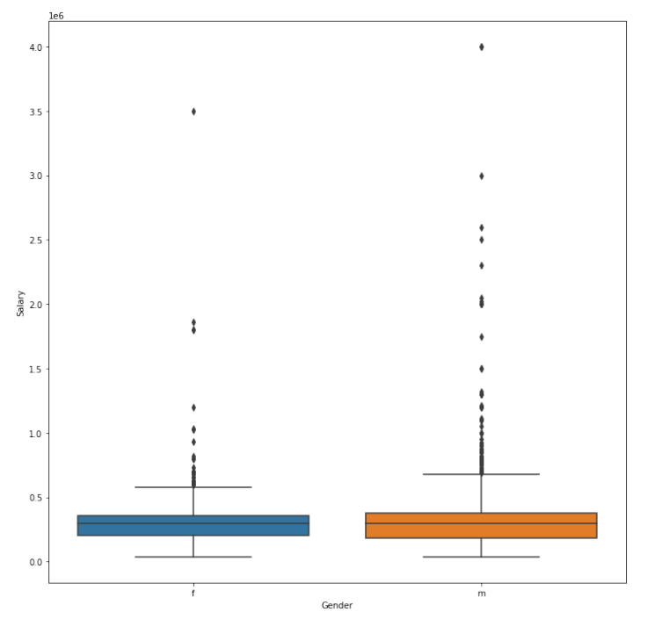
Bivariate Analysis
When looking at the data, we see that males have more salaries that are much higher than the typical range, which are called outliers. This means that some males are earning a lot more compared to the average salary. On the other side, females have fewer extreme salaries and their earnings tend to stay closer to the average.

Slide 9
Objective of the Analysis
Key Insights: This Analysis provided the significant insights into distribution of salaries and the factors influencing them
Skill Impact: Examined the relationship between cognitive, technical, and personality skills with salary outcomes, revealing significant predictors.
GENDER & SPECIALIZATION: The Preferences for specialization appears to have the some correlation with Gender.
Explore Trends: Look into how salaries vary by the factors such as location,gender and job roles to identify the potential inequalities in the job market.
Overall this anaysis aim to provide valuable insights for Engineering Graduates

